Slide 1








Slide 2
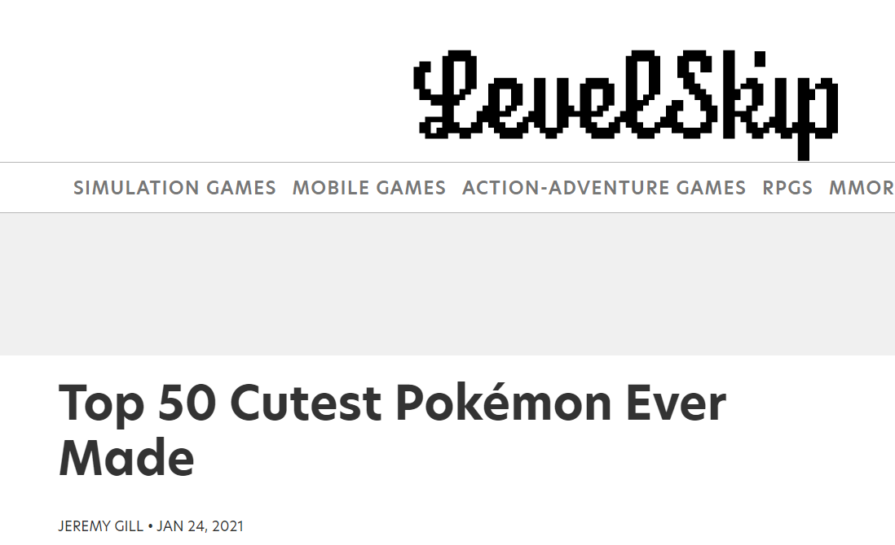
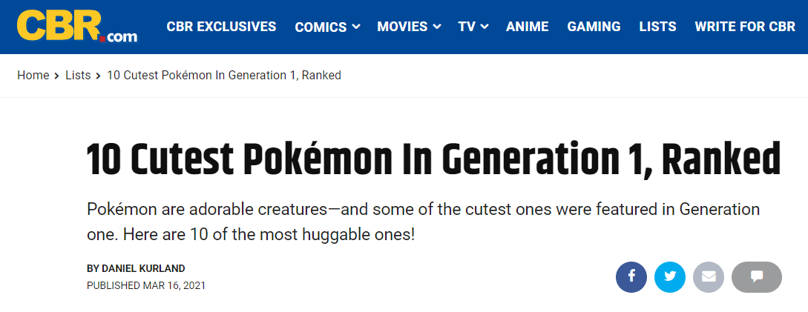
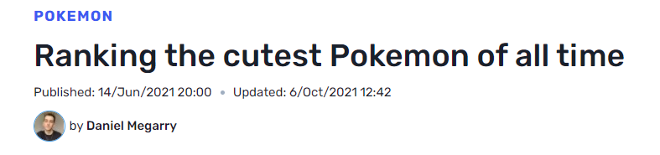
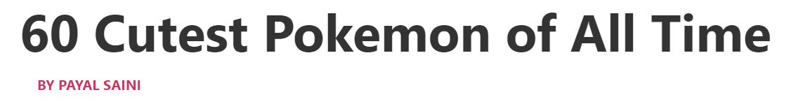
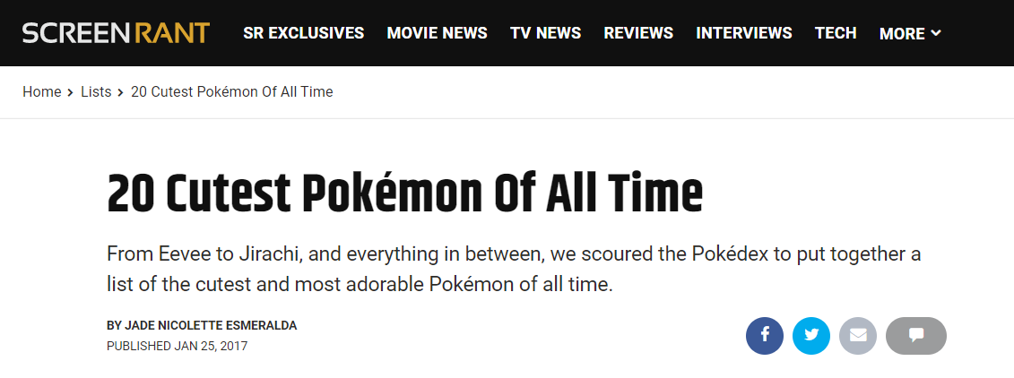
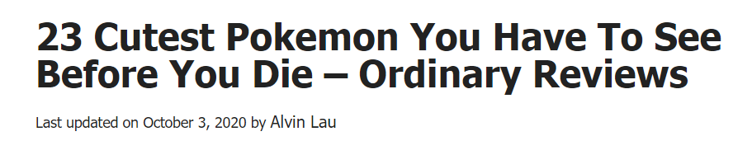
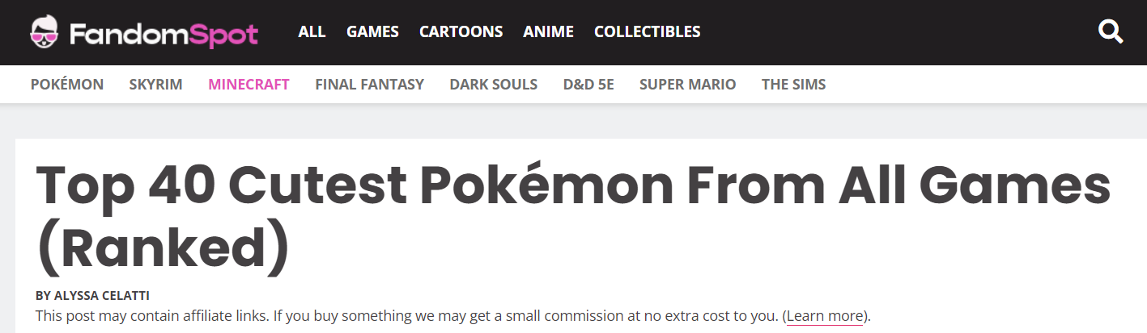

Slide 3
Introduction
Outline
Cuteness
The Webscraping
Creating the SQL Database
How the Database Interacts with PHP
Searching through it
Connecting to it
Sorting on Website
Our Websites
Conclusion and Live Demo

Slide 4
What is cuteness?
Definition
Cuteness
/ˈkjuːtnəs/
noun
The quality of being attractive in a pretty or endearing way.
"the innocence, exuberance, and overall cuteness of all these Pokémon"

Slide 5
What is cuteness?
The 7 criteria
Face to body ratio
Eye to face ratio
Eye roundness
Minimalism
Facial expression
Hugability
Similarity to real world animals

Slide 6
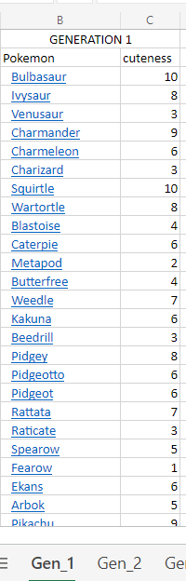
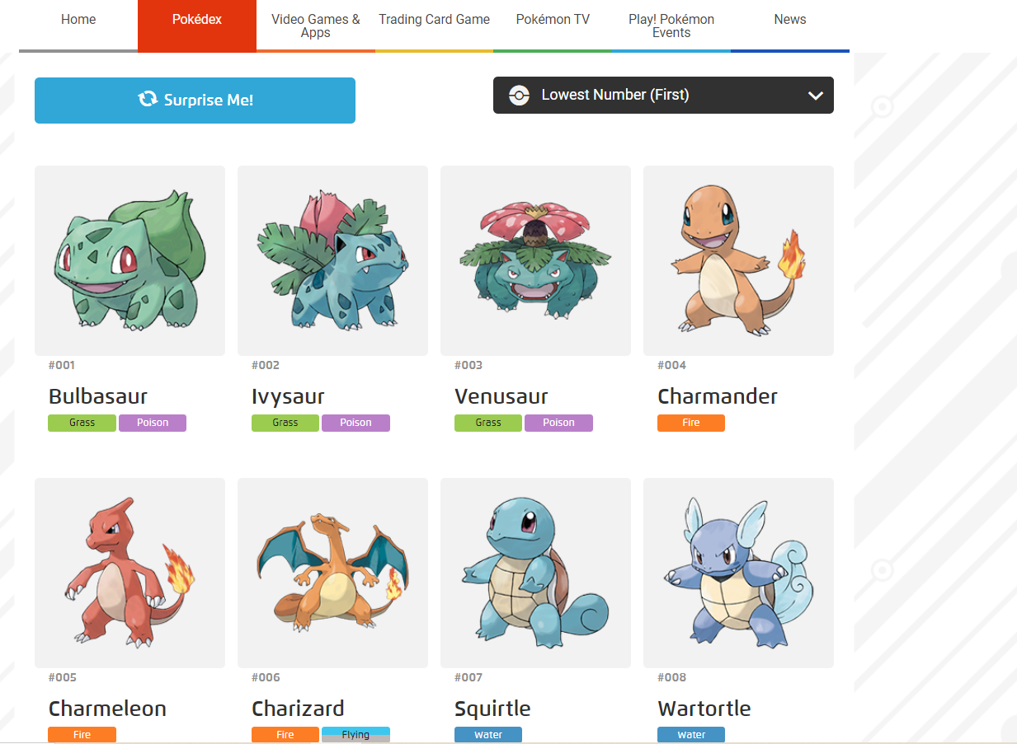



What is cuteness?
Method

Slide 7

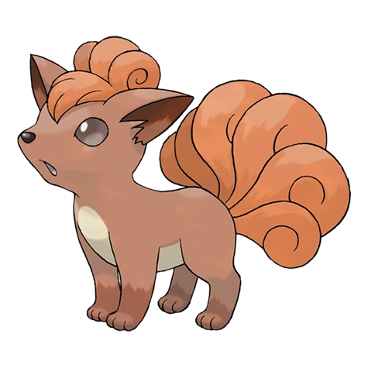

What is cuteness?
Case studies
Vulpix
Poliwrath
Dhelmise
Cuteness: 10
Cuteness: 5
Cuteness: 1

Slide 8
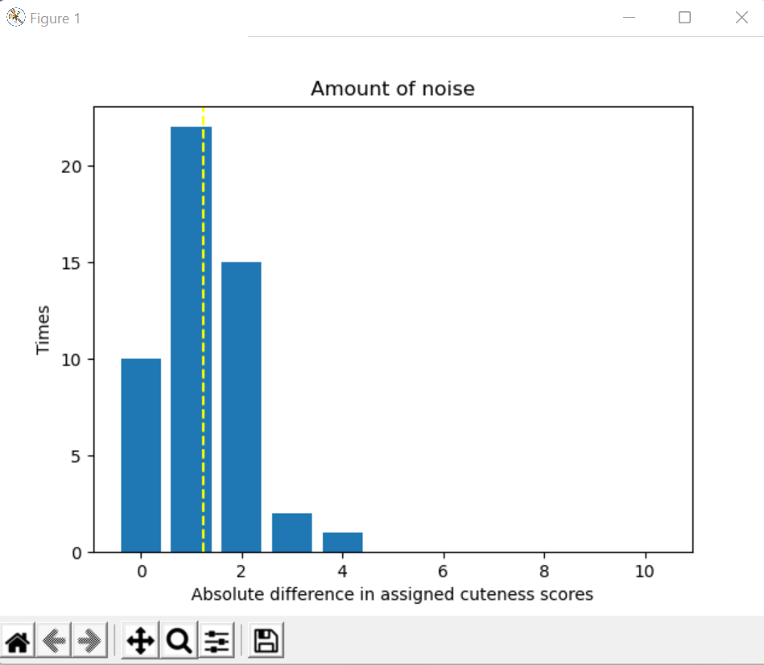
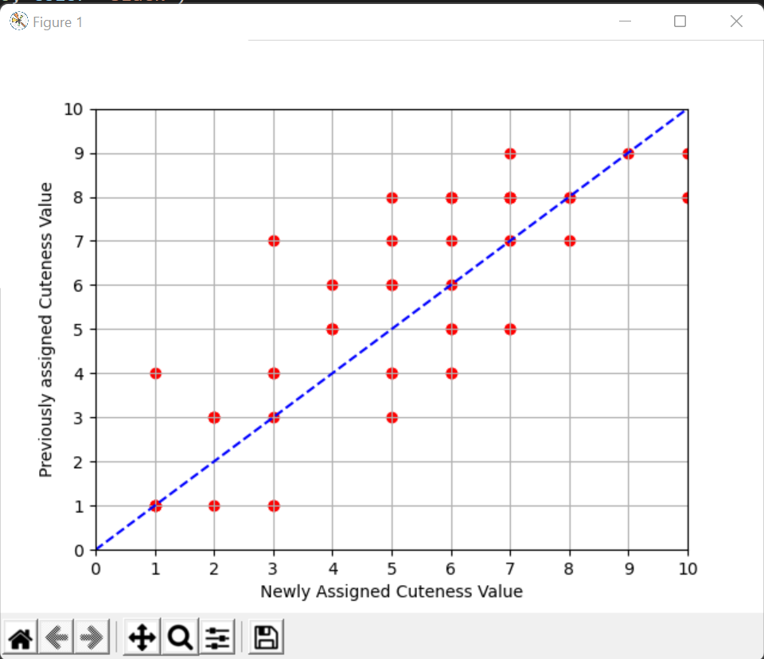
Cuteness Judgements and Occasion Noise
Occasion Noise: Difference in judgements by the same person of the same thing
Were these cuteness scores really judged by a set criteria, there would be no occasion noise
Experiment: Using Python to randomise 50 Pokémon Samo would have to judge once again, without seeing the previous scores assigned, to measure this noise.
Result: Slight occasion noise -> Cuteness scores assigned varied on average by ~1.25

Slide 9
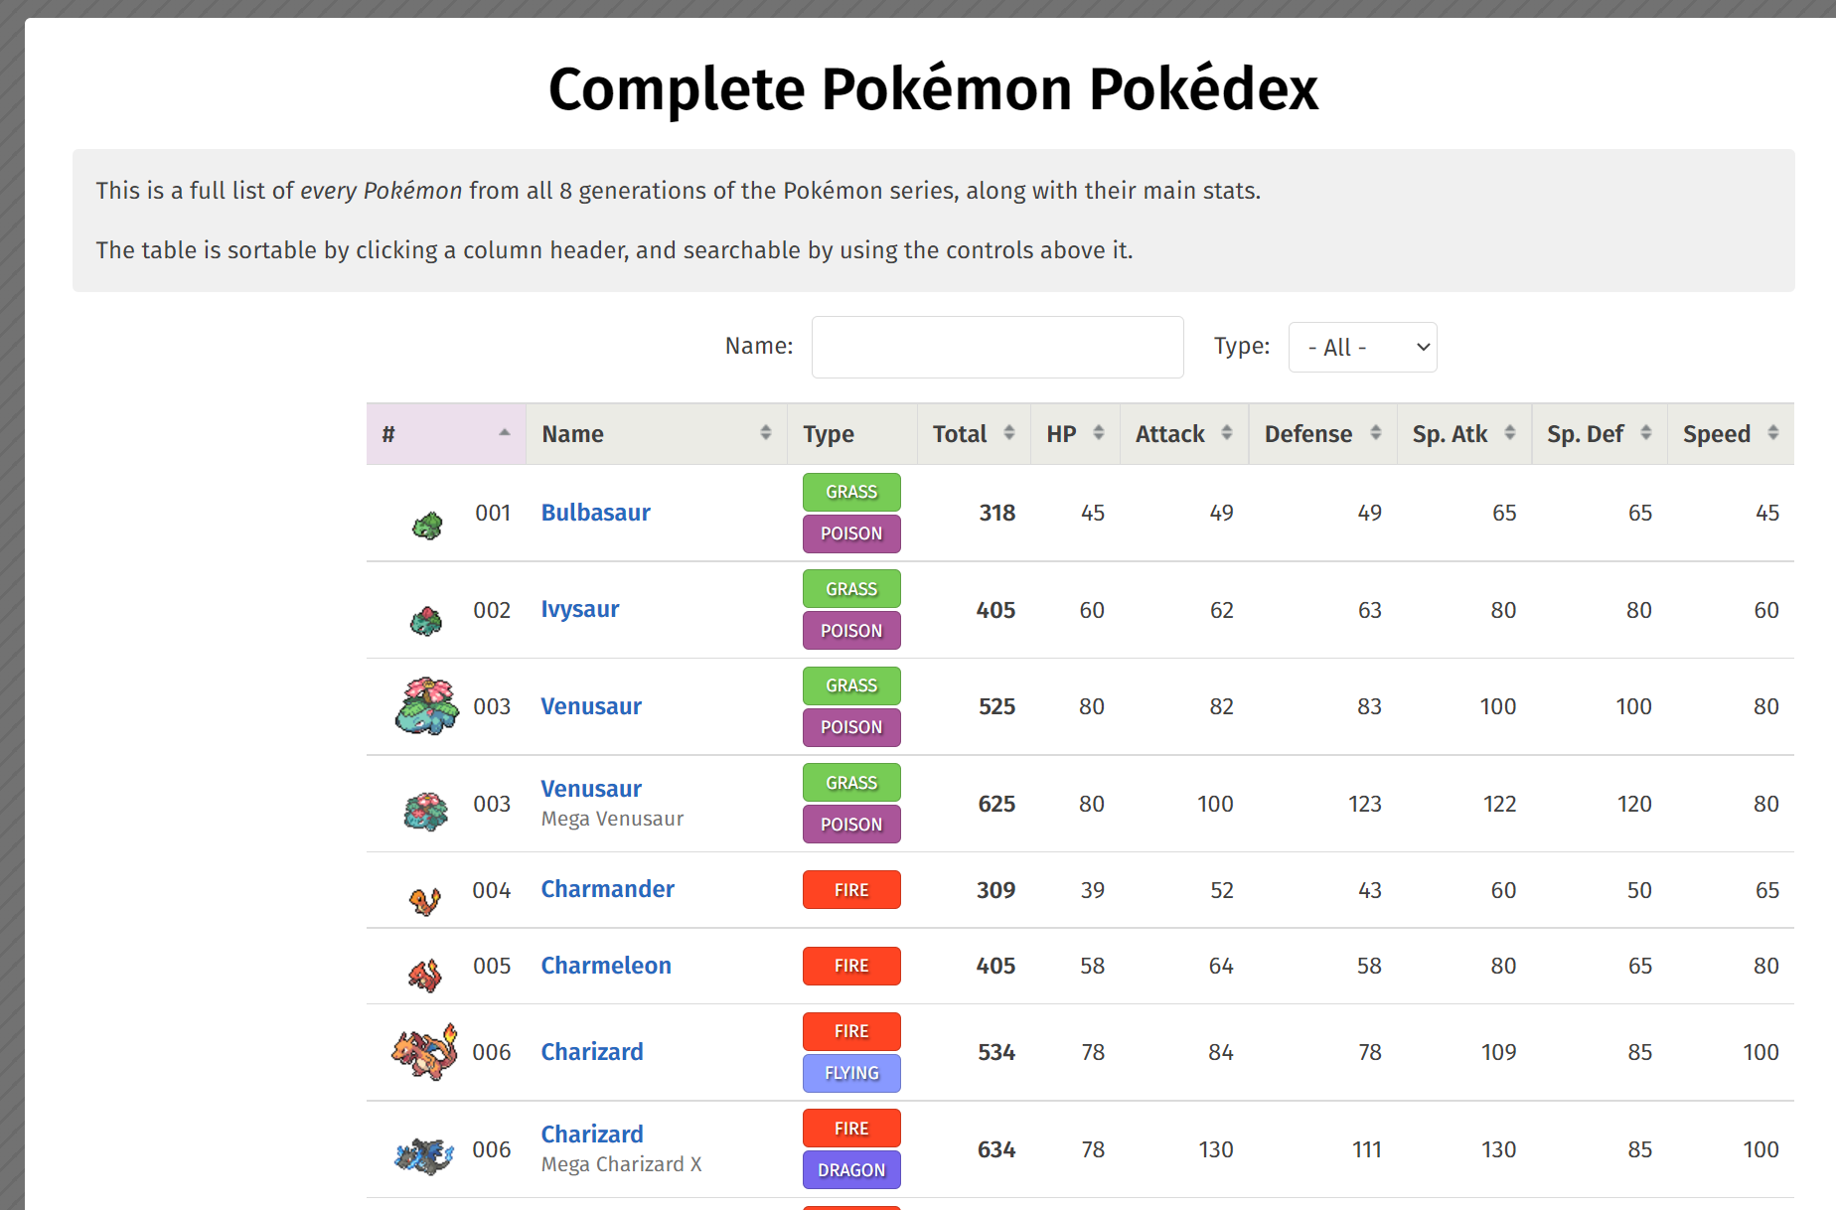
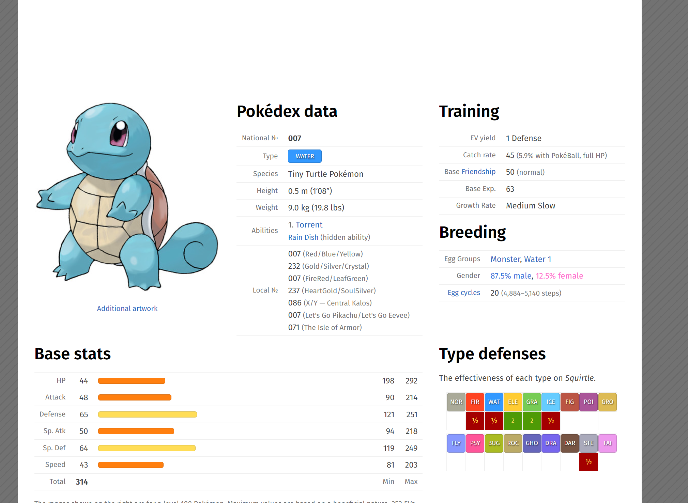
The Webscraper and the SQL Database
Obtaining the Data
Getting all of our data from pokemon.db
Accessing main pokedex-site
From there, gathering all links for individual pages

Slide 10
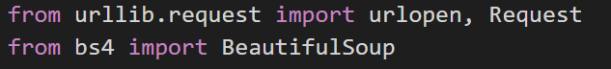
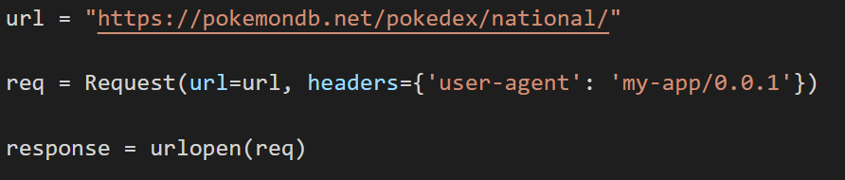
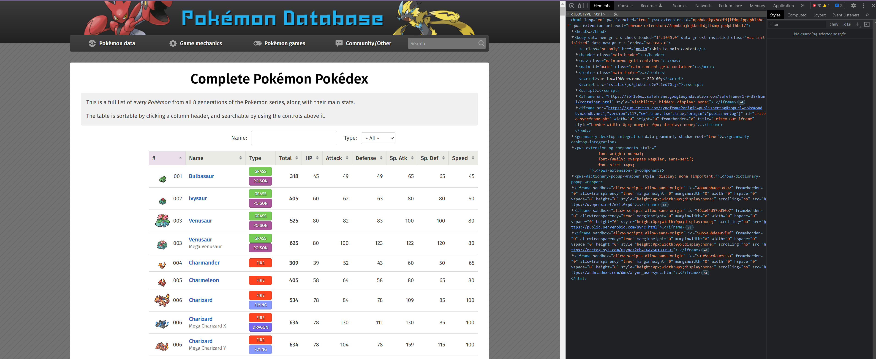
The Webscraper and the SQL Database
Obtaining the Data
Webscraping done using Python
Modules, urllib.request and BeautifulSoup
Urllib.request for making the requests from Python to access sites
BeautifulSoup to import the html source code of site
In total: 899 requests: 898 pokemon sites + main page

Slide 11
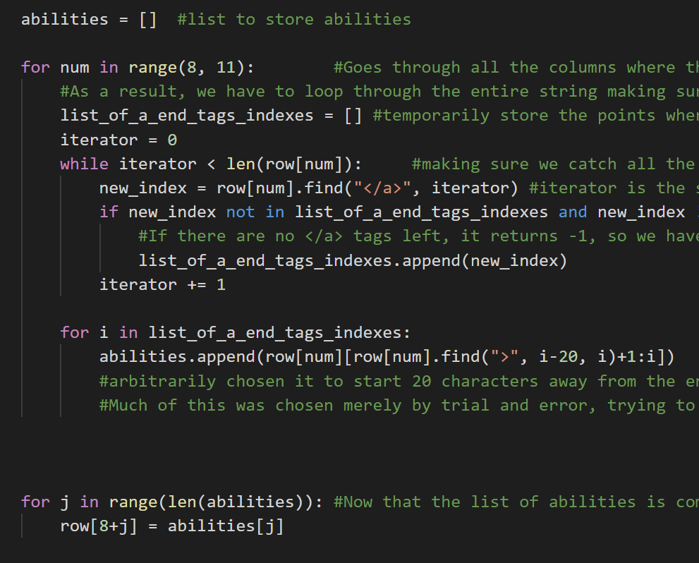
The Webscraper and the SQL Database
Filtering through the Data
Example: Getting abilities from webscraping
Whole source code is imported -> filtering is necessary for usable data
Webscraping -> find patterns to extract correct data
Module ‘BeautifulSoup’ for finding all <a> tags and others, for example
.find in Python also very useful for this
<span class="text-muted">1. <a href="/ability/overgrow" title="Powers up Grass-type moves in a pinch.">Overgrow</a></span><br/><small class="text-muted"><a href="/ability/chlorophyll" title="Boosts the PokÃ©mon's Speed in sunshine.">Chlorophyll</a> (hidden ability)</small><br/>

Slide 12
The Webscraper and the SQL Database
Filtering through the Data
Example: Getting abilities from webscraping
<span class="text-muted">1. <a href="/ability/overgrow" title="Powers up Grass-type moves in a pinch.">Overgrow</a></span><br/><small class="text-muted"><a href="/ability/chlorophyll" title="Boosts the PokÃ©mon's Speed in sunshine.">Chlorophyll</a> (hidden ability)</small><br/>
Up to three abilities for each pokemon distributed in 3 columns from csv file from webscraping
[Overgrow, Chlorophyll]
<span class="text-muted">1. <a href="/ability/overgrow" title="Powers up Grass-type moves in a pinch.">Overgrow</a></span><br/><small class="text-muted"><a href="/ability/chlorophyll" title="Boosts the PokÃ©mon's Speed in sunshine.">Chlorophyll</a> (hidden ability)</small><br/>

Slide 13
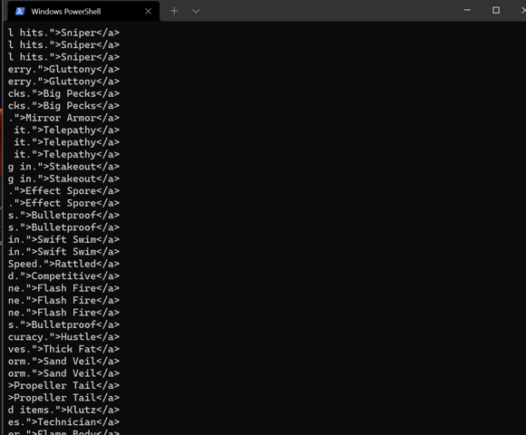
The Webscraper and the SQL Database
Filtering through the Data
Example: Getting abilities from webscraping
Obtaining abilities in two steps. First step gets [i-20:i] where i is index where there was an </a>:
<span class="text-muted">1. <a href="/ability/overgrow" title="Powers up Grass-type moves in a pinch.">Overgrow</a></span><br/><small class="text-muted"><a href="/ability/chlorophyll" title="Boosts the PokÃ©mon's Speed in sunshine.">Chlorophyll</a> (hidden ability)</small><br/>

Slide 14
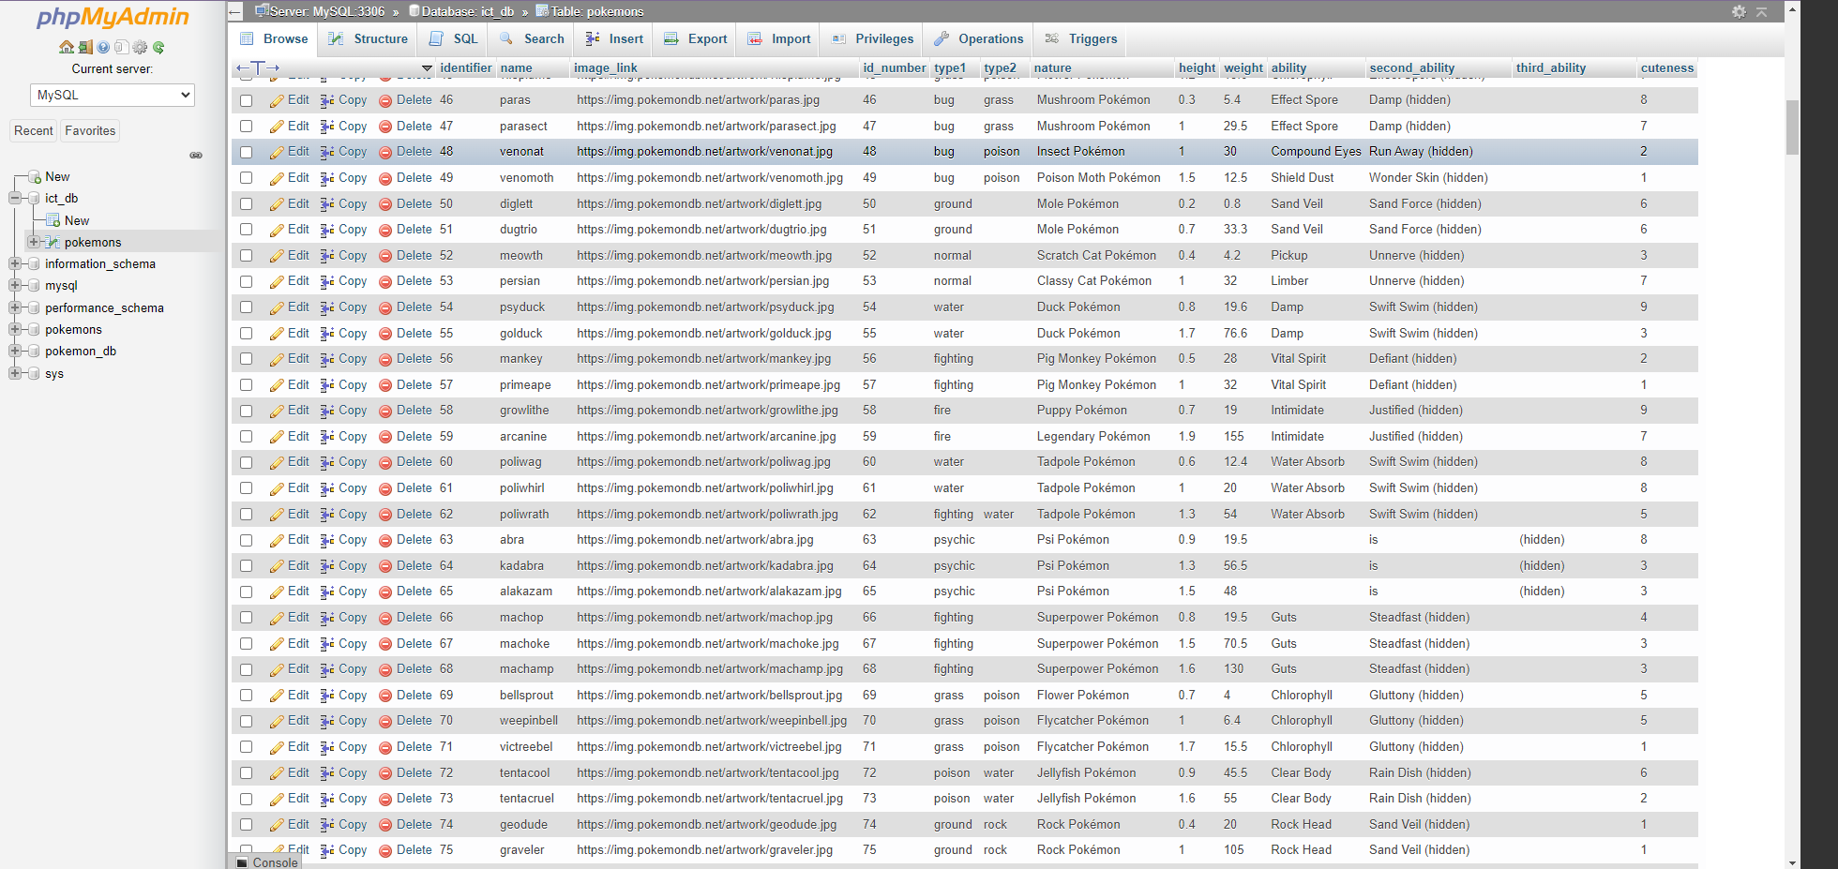
The Webscraper and the SQL Database
Filtering through the Data
Example: Getting abilities from webscraping
However, not all abilities are captured, because of the complexity of the string(s)!
The heterogeneity of the strings, caused some issues
-> Some abilities had to be modified manually in SQL
About 1% of entries ~10 or so pokemon had to be fixed like this
Somewhat successful “cleaning”, but not perfect
-> regex might have been a better option
<span class="text-muted">1. <a href="/ability/overgrow" title="Powers up Grass-type moves in a pinch.">Overgrow</a></span><br/><small class="text-muted"><a href="/ability/chlorophyll" title="Boosts the PokÃ©mon's Speed in sunshine.">Chlorophyll</a> (hidden ability)</small><br/>

Slide 15
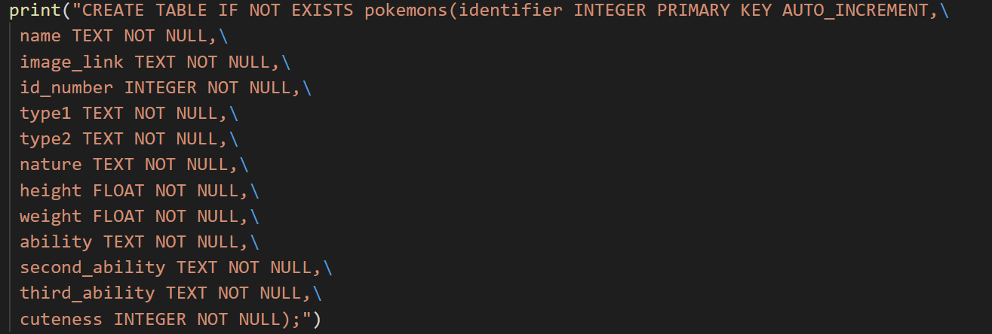
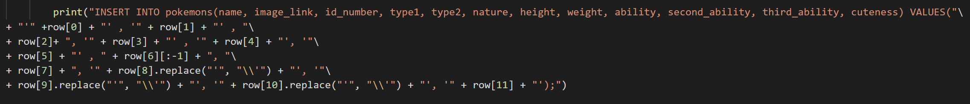
The Webscraper and the SQL Database
Creating the SQL Database
This process of cleaning is repeated for all data points
-> List containing all the data
Creating the SQL table through CREATE command
Filling out the SQL table through 898 insertion commands, inserting the data from this list
All printed out in Python and copy-pasted into mySQL
<span class="text-muted">1. <a href="/ability/overgrow" title="Powers up Grass-type moves in a pinch.">Overgrow</a></span><br/><small class="text-muted"><a href="/ability/chlorophyll" title="Boosts the PokÃ©mon's Speed in sunshine.">Chlorophyll</a> (hidden ability)</small><br/>

Slide 16
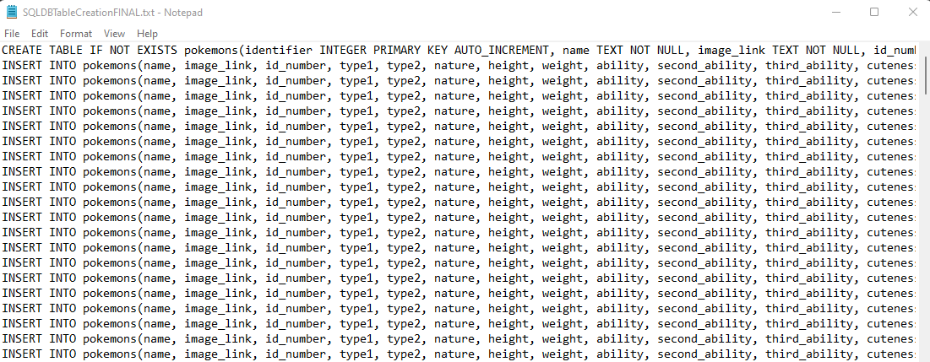
The Webscraper and the SQL Database
Creating the SQL Database
The following is then printed out by Python (outputted into .txt file):
Copy-pasted into mySQL to create entire database
<span class="text-muted">1. <a href="/ability/overgrow" title="Powers up Grass-type moves in a pinch.">Overgrow</a></span><br/><small class="text-muted"><a href="/ability/chlorophyll" title="Boosts the PokÃ©mon's Speed in sunshine.">Chlorophyll</a> (hidden ability)</small><br/>

Slide 17
The Webscraper and the SQL Database
The SQL Databse
<span class="text-muted">1. <a href="/ability/overgrow" title="Powers up Grass-type moves in a pinch.">Overgrow</a></span><br/><small class="text-muted"><a href="/ability/chlorophyll" title="Boosts the PokÃ©mon's Speed in sunshine.">Chlorophyll</a> (hidden ability)</small><br/>

Slide 18
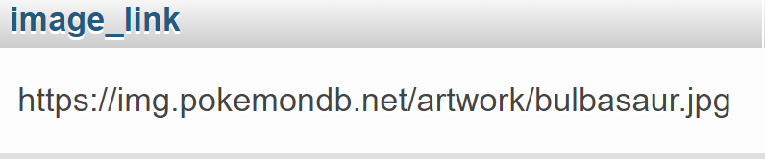
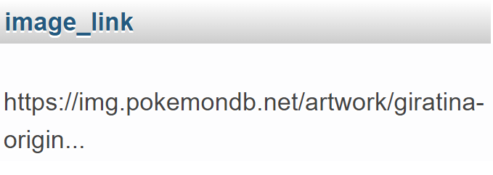
The Webscraper and the SQL Database
Manual Fixes to SQL Databse
Some abilities had to be fixed
Some pokemon have different ‘forms’ (apprx. 5-10)
-> image links had to be fixed
Requires some suffix in the image link
Hindsight: Much easier to just download tables containing all data points
“Normal link”:
“Weird link”:
Suffix: ‘-origin’ here
<span class="text-muted">1. <a href="/ability/overgrow" title="Powers up Grass-type moves in a pinch.">Overgrow</a></span><br/><small class="text-muted"><a href="/ability/chlorophyll" title="Boosts the PokÃ©mon's Speed in sunshine.">Chlorophyll</a> (hidden ability)</small><br/>

Slide 19
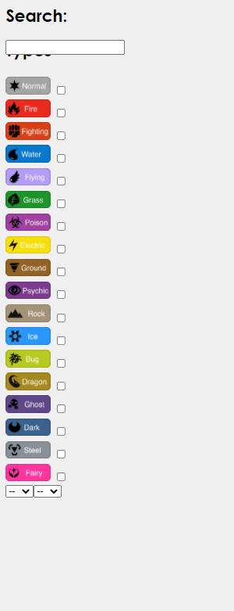
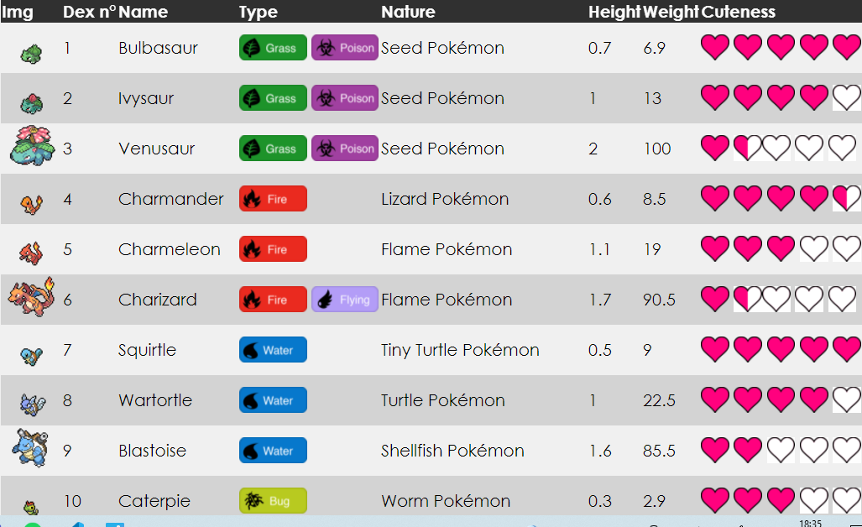
The Database with Searching Mechanisms
Getting elements from SQL and printing them out. (SQL & pHp)
Search mechanism for Pokémon (HTML form)
Reordering the database (SQL & pHp)

Slide 20
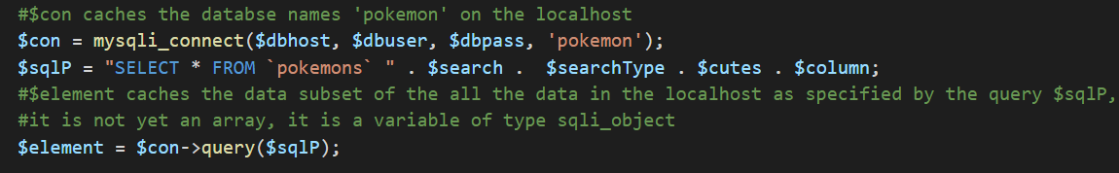
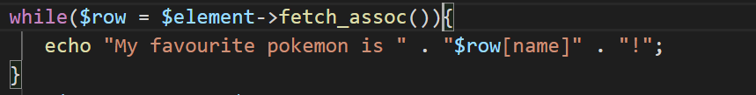
The Database with Searching Mechanisms
Getting elements from SQL and Making table
Connecting to the SQL database from localhost.
Extract elements from filtered data, $row is an array
$row has non-standard keys for an array, $row[0] doesn't return anything

Slide 21
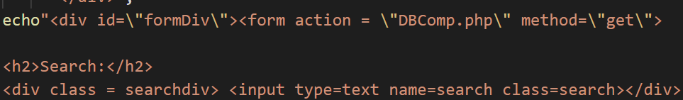
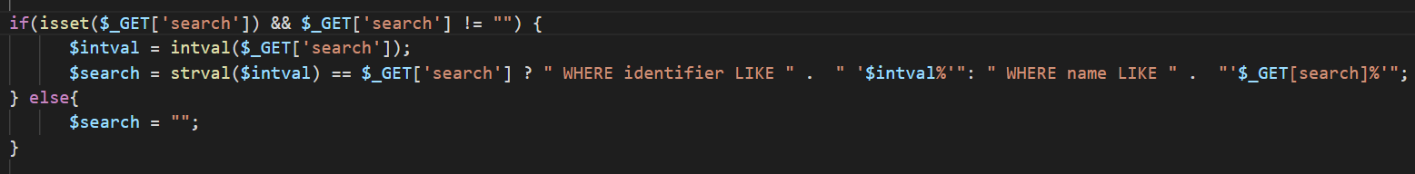
The Database with Searching Mechanisms
Searching Mechanisms -- Search bar
The whole HTML form is of GET method.
Can search identifier or name of Pokémon.
$x == A? B : D;

Slide 22
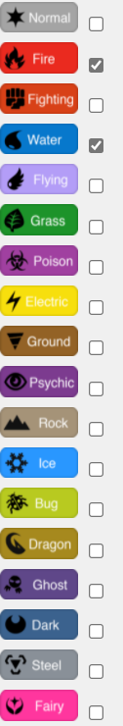
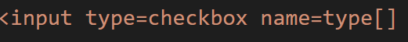
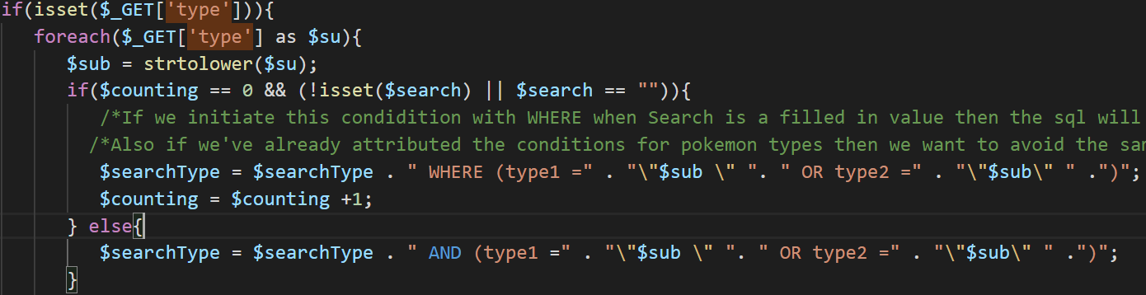
The Database with Searching Mechanisms
Searching Mechanisms -- Type Checkboxes (1 / 2)
Maximum types possible are two -> can return two values
SELECT * FROM `pokemons` WHERE (type1 ="fire " OR type2 ="fire" )
AND (type1 ="water " OR type2 ="water" )
$type is attributed to the SQL request after $search -> we need to avoid error

Slide 23
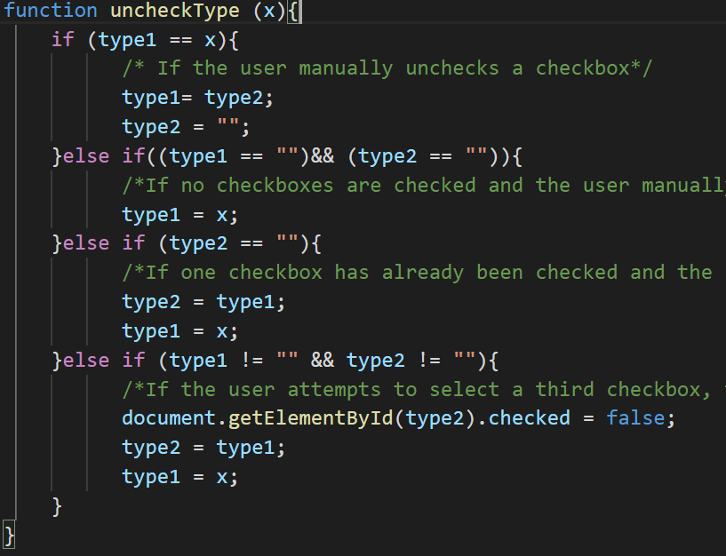
The Database with Searching Mechanisms
Searching Mechanisms -- Type Checkboxes (2 / 2)
Maximum types possible are two -> Restrict user from selecting 3

Slide 24

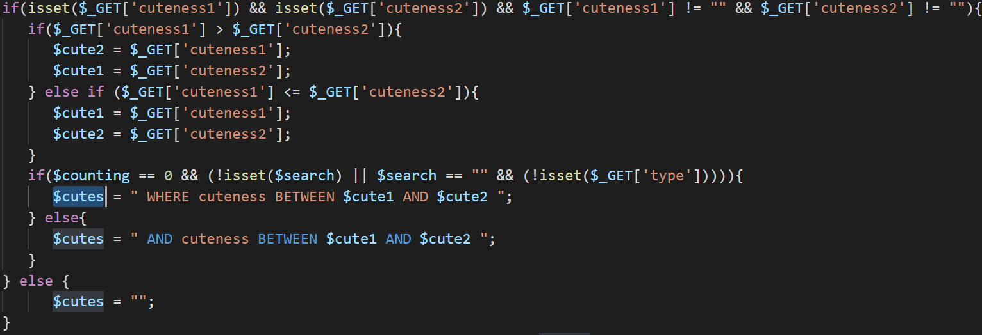
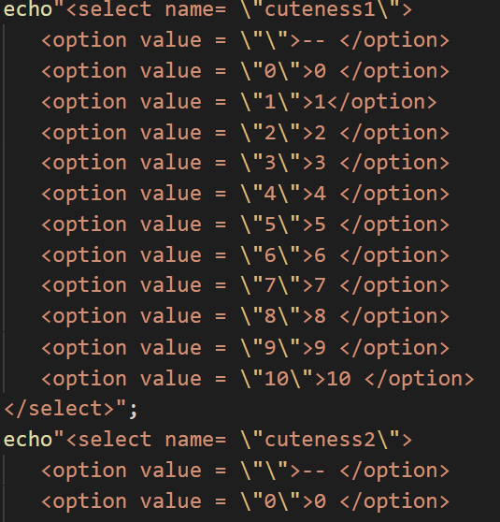
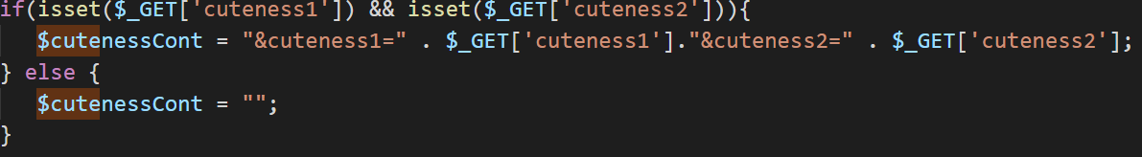
The Database with Searching Mechanisms
Searching Mechanisms -- Cute range
Select a range in which the cuteness lies
Avoid error same as for types

Slide 25
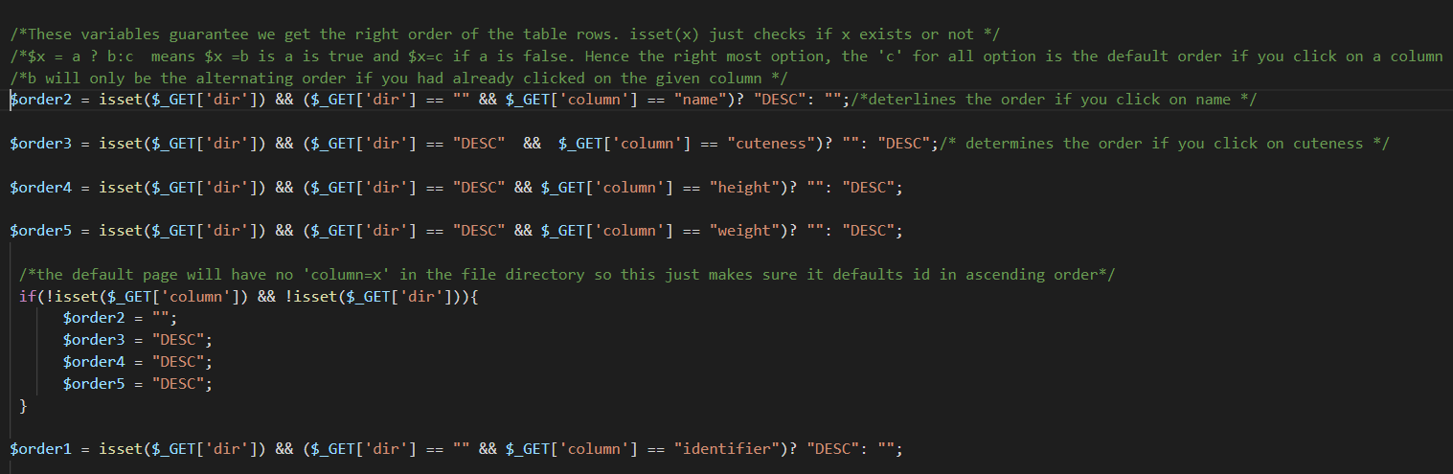
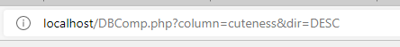
The Database with Searching Mechanisms
Resorting Table (1 / 3)
Logical operators for deciding the order
Extract elements from filtered data, $row is an array
If statement to set default orders, these Orders are added to the directory
-> $_GET[column] == cuteness

Slide 26
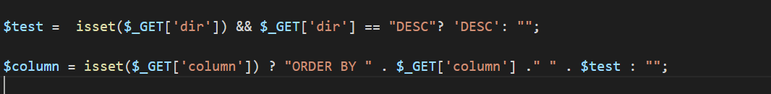
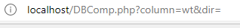
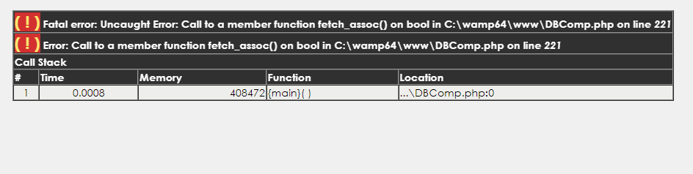
The Database with Searching Mechanisms
Resorting Table (2 / 3)
When $_GET[column] not null, SQL request is modified
$column is attached to the end of the SQL request.
Errors can happen if one edits the directory

Slide 27
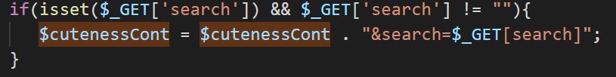
The Database with Searching Mechanisms
Resorting Table (3 / 3)
Keeping search queries when changing order
(inside the loop that makes the types SQL extension)

Slide 28
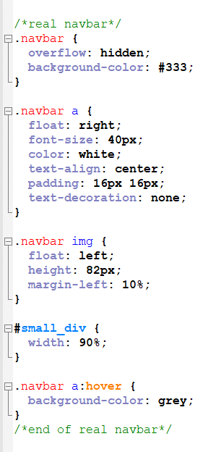

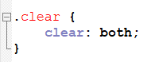
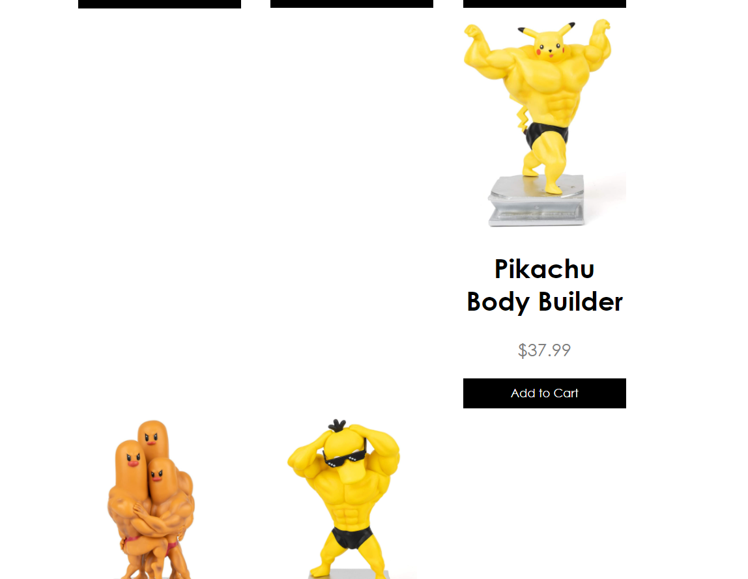
Creating the Website
The Navigation Bar and Blank Div
Prevents navbar from disappearing
Prevents

Slide 29
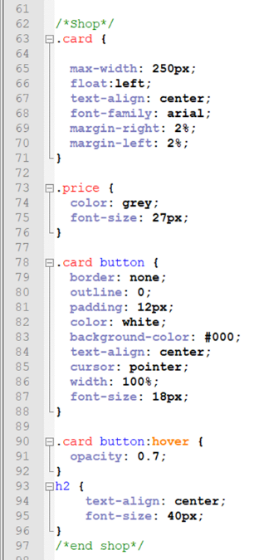
Creating the Website
Shop Page
Makes it so that 3 product cards fit in the same row
Since every picture is a different original size, they all have different width values within the card

Slide 30
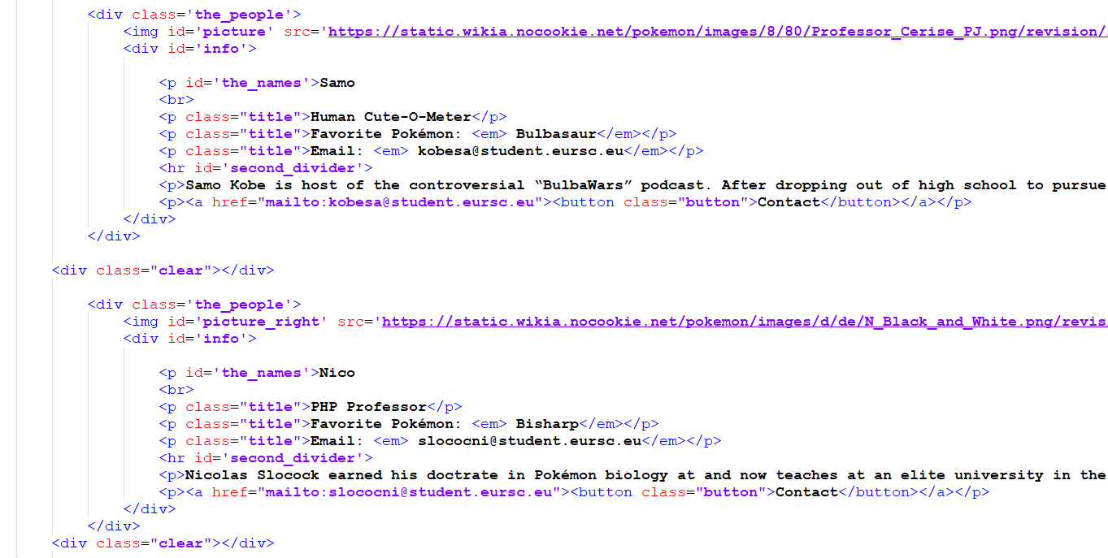
Creating the Website
About Us Page
Different picture IDs to alternate picture side
Opens Email when clicked

Slide 31
Conclusion
Forwards Compatibility?
Entirely reliant on pokemon.db database being updated
As long as that site is updated, our data should remain so too
-> Advantage of webscraping over downloading tables
However, it would require the aforementioned manual fixes to some ability names and image links
Websites, too, will automatically update when webscraping is done once again
‘Future-proof’, but requires:
Run webscraping again and make the new SQL table
Fix problematic abilities and image-links.

Slide 32


THANK YOU FOR LISTENING

